Slide 1


Digital Portfolio
STUDENT NAME: A.YAMUNA
REGISTER NO AND NMID: 212406224
DEPARTMENT: COMPUTER APPLICATION
COLLEGE:MANGALAM OF ARTS AND SCIENCE

Slide 2

PROJECT TITLE
Interactive digital portfolio using front end development

Slide 3
AGENDA
1.Problem statement
2.Project overview
3.End users
4.Tools and technologies
5.Portfolio design and layout
6.Features and functionality
7.Results and screnshot
8.Conclution
9.Github link

Slide 4

PROBLEM STATEMENT
A well-crafted portfolio can open doors, but building one can be challenging. This project aims to simplify that process with a responsive, customizable website.

Slide 5
PROJECT OVERVIEW
This project involves the development of a modern and responsive digital portfolio designed to help
individuals showcase their academic, professional, and technical achievements. The portfolio includes
key sections such as &quot;About Me&quot;, &quot;Education&quot;, &quot;Skills&quot;, &quot;Certificates&quot;, and a &quot;Contact&quot; form for easy
communication. The main goal is to provide a personalized online space that highlights the user’s
strengths and experiences through an interactive and visually appealing interface.

Slide 6
WHO ARE THE END USERS?
HTML Structure (pages, sections). CSS Styling (colors, layouts, responsiveness). JavaScript Interactivity (navigation menu, animations, form validation) Mention code editor (VS Code) and hosting platform (GitHub Pages) JavaScript Interactivity (mobile navigation menu toggle) Inbox yamuna

Slide 7
TOOLS AND TECHNIQUES
Students (academic projects, resumes).Job seekers (to share with recruiters).Freelancers (to show clients).Professionals (to highlight experience and achievements)

Slide 8
POTFOLIO DESIGN AND LAYOUT
PORTFOLIO DESIGN AND LAYOUT
• Home
• About Me
• Skills
• Projects
• Achievements
• Contact

Slide 9
FEATURES AND FUNCTIONALITY
Responsive navigation bar with hamburger menu for mobile view
• Skills section displayed using simple list
•Certificates section displayed in grid format
• Contact details with email,-phone number
• Footer copyright

Slide 10
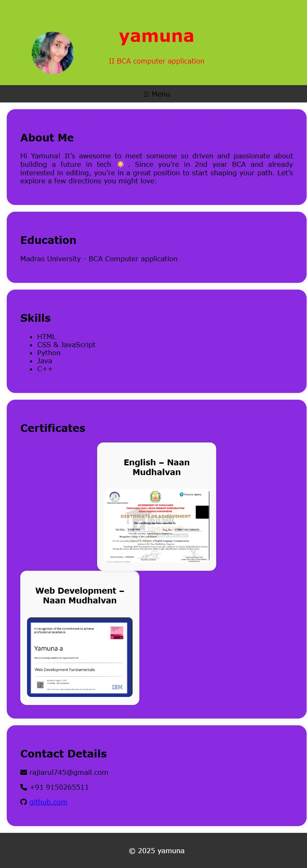
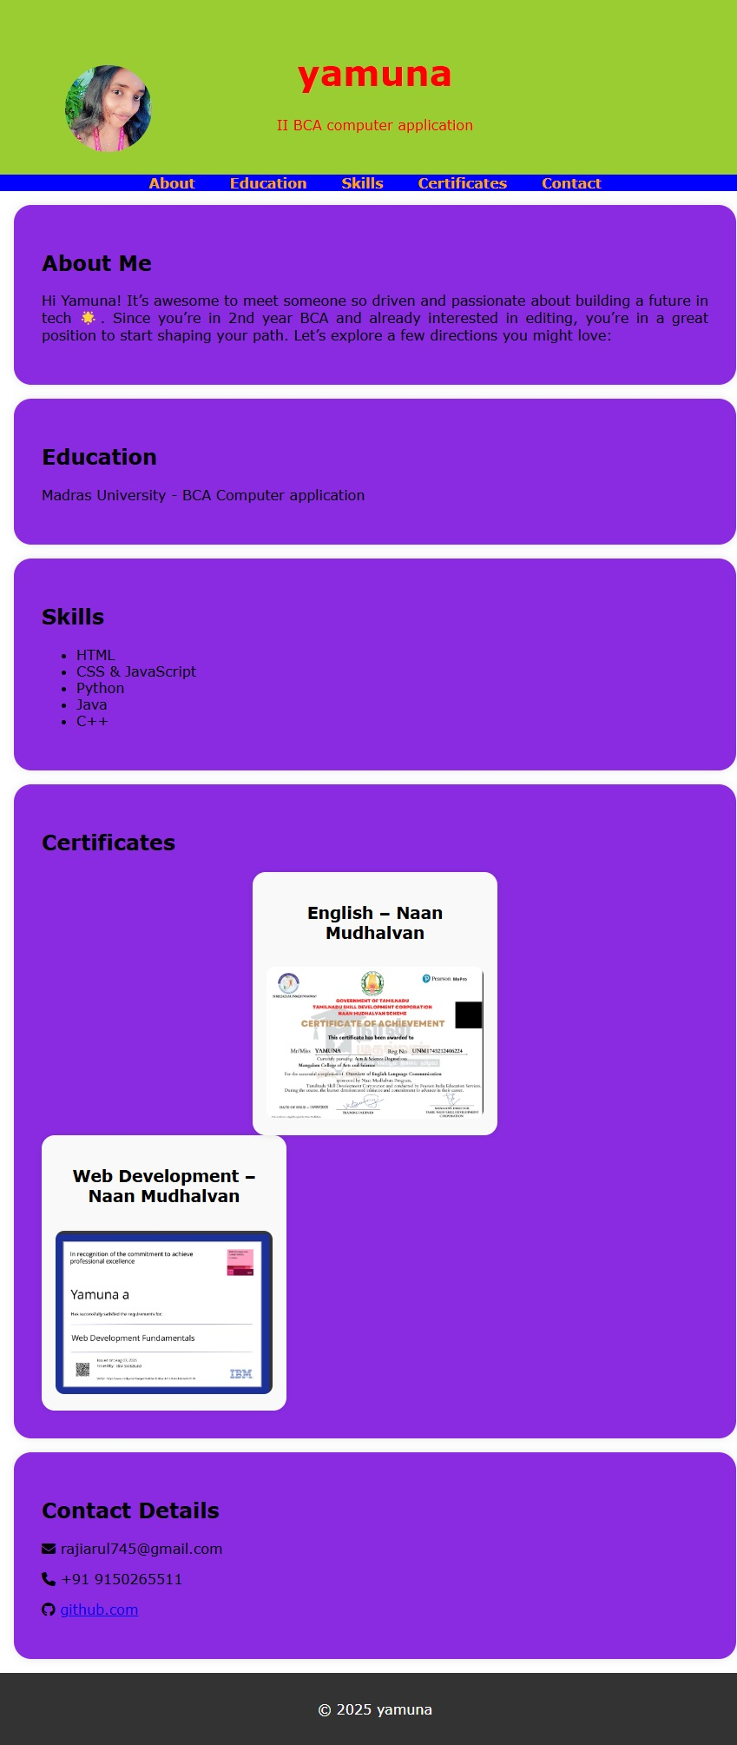
RESULTS AND SCREENSHOTS
Mobile view
Desktop view

Slide 11
CONCLUSION
The portfolio demonstrates how a structured layout can showcase both academic and personal
interests. It provides easy navigation, responsive viewing, and a clean user experience.

